Slide 1
Labour Relations And Labour Regulations In Nepal

Slide 2

Labor Relations
Labor relation refers to the system in which employers, employees and their representatives and government interact to situate the ground rules for the governance of work relationship.

Slide 3

Objectives of Labor Relations
1. Harmonious relation:
2. Quality working condition:
3. Increasing the productivity:
4. Effective communication:
5. Improving participation:
6. Industrial peace:

Slide 4
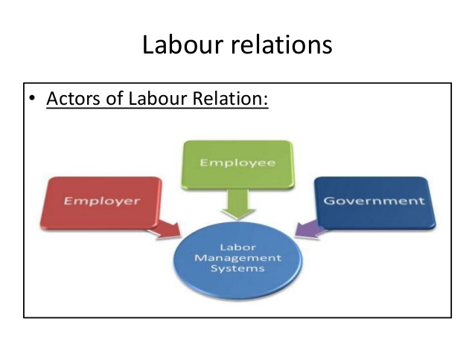
Actors of Industrial Relation system
1. Employee/Labor:
2. Employer:
3. Government/Society:
4. Others:

Slide 5
Trade Unions
It is an organization of workers or employees formed mainly
→ to negotiate with the employers on various employment related issues
→ to improve the terms and conditions at their workplace
→ to enhance their status in society.
An organization that represents employees’ interests to management on issues such as wages, work hours, and working conditions
An organisation formed by workers to protect the interests of their members.

Slide 6
Functions Of Trade Union
Collective bargaining
→Represent members to negotiate with employers, for better wages and conditions of employment
Safeguard jobs
→Protect jobs of members
Cooperate with employers
→For the benefits of members, resolve disputes in a mutually acceptable manner
Political function
→Support pro-union political parties
Social function
→ Support members with recreation facilities and benefits for unemployment, illness, retirement, death

Slide 7
Types of Trade Union
Types Of Trade Union
Crafts Unions
Industrial Unions
House Union
White Collar Unions

Slide 8
Types of Unions … continued
Industrial Unions or Employers’ Unions:
Members work in the same industry, e.g. banking (IBOA), PABSON etc.
Craft Unions:
Members belong to a particular trade and have served an apprenticeship e.g. Brick and Stone layers Trade union, Barber’s union etc.
White Collar Unions:
Members are usually professional e.g. teachers unions, NELTA etc.
House union (company or enterprise union)
Members are from the same company regardless of occupation or job.

Slide 9
Reasons For Joining a Trade Union
Greater Bargaining Power.
The individual employee possesses very little bargaining power as compared to that of his employer. If he is not satisfied with the wage and other conditions of employment, he may join union to have greater bargaining power.
Make their Voices Heard
The desire for self-expression is a fundamental human drive for most people. All of us wish to share our feelings, ideas and opinions with others. Similarly the workers also want the management to listen to them and it is possible through Trade Unions.

Slide 10
Reasons For Joining a Trade Union … continued
Sense of Security
The employees may join the unions to secure adequate protection from various types of hazards and income insecurity such as accident, injury, illness, unemployment, etc. The trade union secure retirement benefits of the workers and compel the management to invest in welfare services for the benefit of the workers.
Sense of Participation.
The employees can participate in management of matters affecting their interests only if they join trade unions. They can influence the decisions that are taken as a result of collective bargaining between the union and the management.

Slide 11
Reasons For Joining a Trade Union … continued
Sense of Belongingness
Many employees join a union because their co-workers are the members of the union.

Slide 12
Major Trade Unions In Nepal
Nepal Trade Union Congress (NTUC)
General Federation Of Nepalese Trade Unions (GEFONT)
Democratic Confederation Of Nepalese Trade Unions (DCONT)

Slide 13
National Trade Union Congress
Established in 1947.
Main objective: Promoting workers rights.
The ideology of NTUC was based on democracy, socialism and nationalism.
After the establishment of democracy in 1950, NTUC became active for the collective welfare of workers until it was all stopped for almost 30 years due to panchayat system.
In 1990 after NTUC revived itself following the popular restoration of democracy.
NTUC works closely with the nepali congress party.

Slide 14
National Trade Union Congress … continued
Affiliates
Nepal Factory Labour Congress | Nepal Tourism and Hotel Workers Union
Nepal Press Union | Nepal Tea Garden’s Worker Union
Nepal Garment Worker’s Union | Nepal Carpet Worker’s Union
Nepal Teacher’s Association | Nepal Shop Worker’s Union
Nepal Health Professional Association | Nepal Wood Worker’s Union
Nepal Electric Worker’s Union | Nepal Rickshaw Driver’s Union
NTUC has eight more affiliates … [1]

Slide 15
General Federation Of Nepalese Trade Unions
Established in July 20, 1989
It established with four founder federations: - Nepal Independent Worker’s Union - Independent Transport Worker’s Association of Nepal - Nepal Independent Worker’s Union - Trekking Worker’s Association of Nepal
It is affiliated to Communist Party of Nepal and Unified Marxist-Leninist Party

Slide 16
General Federation Of Nepalese Trade Unions … continued
Affiliates
Nepal Independent Worker’s Union | Independent Textile and Garment Workers Union Nepal
Independent Transport Worker’s Union of Nepal | Nepal Independent Hotel Worker’s Union
Union of Trekking, Travel & Rafting Workers - Nepal | Independent Tea Plantation Workers' Union of Nepal
Federation of Agricultural Workers, Nepal | Central Women Workers' Department and special arrangements
And many more

Slide 17
Democratic Confederation Of Nepalese Trade Unions
Established on August 14, 1997 after it broke away from NTUC.
Not directly affiliated to any political party but has relations with few political leaders.

Slide 18
Democratic Confederation Of Nepalese Trade Unions …continued
Affiliates
Construction and Allied Workers' Union of Nepal | Nepal Custom and Airport Workers' Union
Nepal Film Workers' Union | Nepal Commercial Workers' Union
Nepal Small Hotel and Restaurant Workers' Union | Nepal Printing Press Workers' Union
Nepal Factory Workers' Union | Nepal Automobile Workers' Union
Many More

Slide 19
Collective Bargaining
Collective Bargaining is a process in which the representatives of a Labour organization & the representatives of business organization meet and attempt to negotiate a contract or agreement, which specifies the nature of employee-employer union relationship”.
It is the process of negotiation between firm’s and workers’ representatives for the purpose of establishing mutually agreeable conditions of employment
It is a technique adopted by two parties to reach an understanding acceptable to both through the process of discussion and negotiation

Slide 20
Process of Collective Bargaining
Definition: The Collective Bargaining is a technique to reach a mutual agreement between the employer and the employee. Here the representatives of both the parties viz. The union and the employer meet and discuss the economic issues such as wage, bonus, number of working hours and other employment terms.

Slide 21
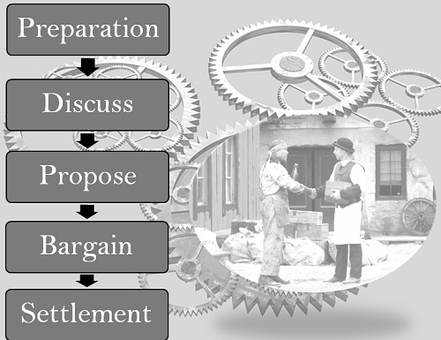
Process of Collective Bargaining

Slide 22
Issues of Collective Bargaining
Mandatory Issues: Compensation Packages, Worker's Rights, Employer Rights, Arbitration.
Illegal Issues: Closed shop, Different wage rate for same level of employees, Separation of employees based on race.
Voluntary Issues: Union affairs , Indemnity bonds, Pension benefits

Slide 23
THANK YOU !!!

